Slide 1


Chapter 11
JavaScript templating

Slide 2
Learning objectives
1. What is JavaScript templating
2. What is Handlebars
3. How to create apps using Handlebars

Slide 3
JavaScript templating
HTML5 along with CSS3 are used to control the content and display of our pages and screens.
Content management systems
Provide limited flexibility.
An alternative is templating.
Templating consists of code similar to HTML5 with some additional syntax.
Provides a consistent look and feel that is useful when the layout is the same throughout a website.
Helpful when a lot of data is being shown, such as displaying a large array of objects.

Slide 4

Explorador app
Access the app using the URL: http://140.184.132.239:8080
The main use of this app is to make selections of where the user would like to find parks by region and what the user wants to do at the park by category, or by searching for the park by name.

Slide 5
Explorador design
An interactive app designed to help users in Halifax, a Canadian city, find parks of interest based on location and amenities.
Flowcharts map out how users move through the app at a high level.
Wireframes are mock-ups of the app pages to help define the layout or structure of each page.
Design decisions in the Explorador app include using a sliding menu that appears at the left of the screen when users slide their fingers to the right.

Slide 6
Introduction to JavaScript templating using Handlebars
First Handlebars file is called header.handlebar in the subdirectory views/layout.
A sequence of stylesheets from various sources including Bootstrap that was used before.
Metro-vibes package from PixelKit that adds unique styling to the common Bootstrap elements, such as buttons and toolbars.
Using some of the stylesheets from ESRI, www.esri.com

Slide 7
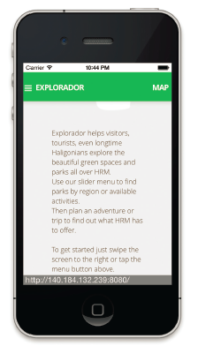
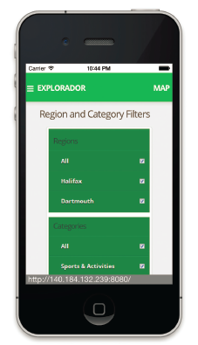
Tutorial for the app

Slide 8
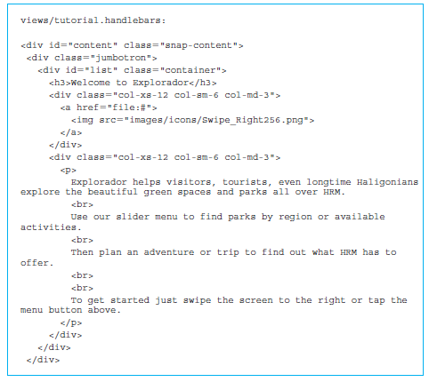
HTML5 code for the tutorial for the Explorador server—I

Slide 9
Bootstrap library
One interesting feature in <div> sections is the use of a variety of “col” classes from the Bootstrap library.
Includes a grid-based column system to provide developers with an easy way to format content on the screen for any possible screen size.
Bootstrap divides content on the screen with a grid of 12 invisible columns.

Slide 10
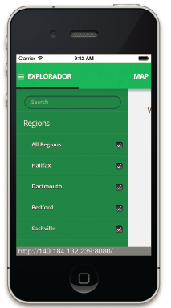
Iteration and arrays in Handlebars
The project is available at (https://github.com/jakiestfu/Snap.js/).
The menu is enclosed in a <div> section with the class snap-drawers, defined in snap.css and is meant to contain a collection of <div> sections with class snap-drawer.

Slide 11
Iteration and arrays in Handlebars (cont’d)
Two sections, the first with the header “Regions” and the other with the header “Categories”.
Region means a geographic region such as Halifax, Bedford, Dartmouth, and so on.
The categories are based on the type of services available in the park, such as sports or water activities.
Each element of the array is referred to as {{this}} within the {{each}} block of our code <label>{{this}}</label}
{{addOne @index}} is a helper function that adds one to the index of that array element.

Slide 12
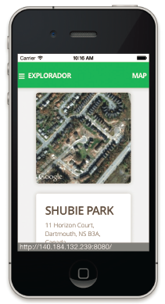
Iteration and arrays in Handlebars (cont’d)
The screenshot of the list of results obtained by a search.
Enclosed the entire page in a <div> section with id “content” and class “snap-content”.
<div> section with class “jumbotron” to display it on a gray block. Iterate through the array using the Handlebars element:
{{#each parks}...{{/each}}

Slide 13
Iteration and arrays in Handlebars (cont’d)
Each result is enclosed in a <div> section with the row class from Bootstrap, which spans all 12 columns.
Features using the Handlebars elements {{name}}, {{location.address}}, {{formatFeatTypes featTypes}}, and {{distance}}.

Slide 14
Conditional statements in Handlebars
Contain the entire page in a <div> section with id “content” and the class “snapcontent” from Snap.js.
A <script> element runs the loadMap() function.
Two <div> sections inside, the first spanning 4 columns and the second spanning 8 columns.

Slide 15
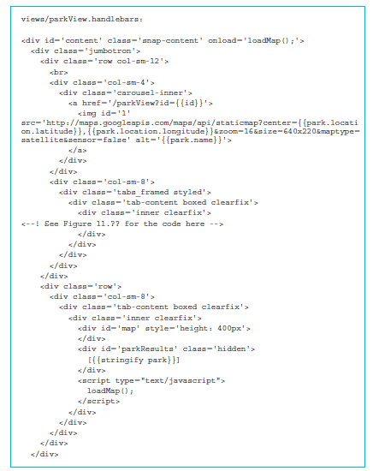
Conditional statements in Handlebars (cont’d)

Slide 16
Conditional statements in Handlebars (cont’d)
Stringify applies the JavaScript stringify function to the JSON object and returns it as a string.
The class for <div> section “parkResults” was “hidden” which is an HTML5 class that means the information is not displayed on the screen, although it is included in the page on the web browser.
Sequence of conditional constructs
{{#ifEqual this 'BOAT LAUNCH SMALL'}}
<img src='images/icons/boat.svg' height='50' width='50'>
{{/ifEqual}}

Slide 17
Quick facts/buzzwords
JavaScript templating: Creating a consistent look and feel for a web app by allowing reuse and simplification of HTML5.
Handlebars: A popular package for JavaScript templating.
{{. . .}}: Double braces used to enclose Handlebars directives.
{{> }}: Handlebar directive to include other partial Handlebars files.
Snap.js: An open source library to add sliding menus.
PixelKit: A package to add more unique styling to the Bootstrap library.
{{#each array}}. . .{{/each}}: Handlebars construct to iterate through an array of objects.

Slide 18
Quick facts/buzzwords (cont’d)
{{this}}: Handlebars construct to denote entire object in the current context. Denotes the entire current object of the array when used in an {{#each}}…{{/each}} block.
{{@index}}: Handlebars construct to denote index of the current object in the array.
maps.googleapis.com: Website that provides an application programming interface to Google maps.

